Slide 1
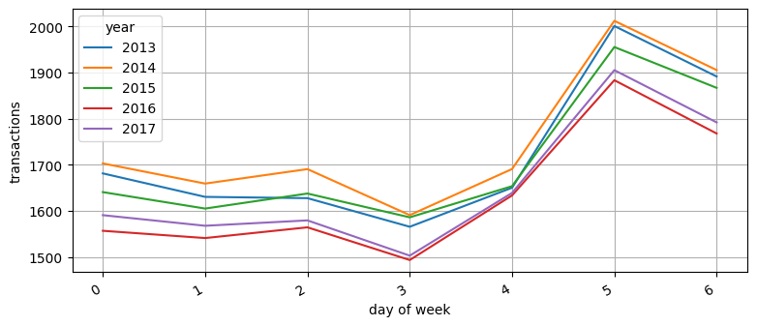
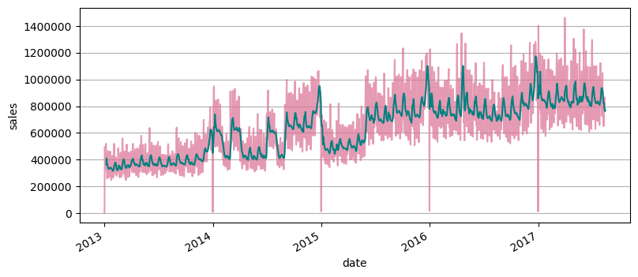

USU CS 4320: Machine Learning, Fall 2022
Store Sales in Ecuador
Corbin Park, Charisse Spencer
Categorial Data Fields:
store_type: Category – Label Encoded Identifier for the store items were sold at
date: YYYY-MM-DD – Special processing* from 2013 to 2017 - Index
store_nbr: Integer – Passthrough Identifier for the store items were sold at
family: Category – Label Encoded The general type of product E.g. hardware, deli
onpromotion: Integer – Passthrough
sales: Float – Target Amount of product sold, varies by product
Data Exploration:
Average Weekly Transactions
Sales over the Years
Trends Data Fields:
*Calendar functions (see CalendarFourier() and DeterministicProcess() from statsmodels for seasonal processing) were used to correlate monthly and general seasonal trends with dates in the training dataset. This became the trends dataset.
The original (processed, see top left) categorical dataset, in conjunction with the trends dataset, was used to train and test the best performing models (see Feature Tuning).
Sales:
The target for prediction was the amount of sales. This varies according to the individual product types (e.g. gallons of beverages, pounds of produce, item counts, etc.), hence the broad variation in the graph above. However, the average shows clear general, yearly, and seasonal trends. Sales was also linearly dependent on number of transactions.
Evaluation Metric:
Root Mean Squared Logarithmic Error
$$\sqrt{\frac{1}{n}+\left(\sum_{i=1}^{n}{(log\left(1+{\overline{y}}_{i}\right)+\log{{\left(1+y_{i}\right))}^{2}}}\right)}$$
Scores (lower is better):
Dummy: 4.37969
Linear Regressor+: 2.15884
Linear Regressor: 1.66704
CatBoost: 1.52782
CatBoost + Linear Reg: 0.91495
2017 Data Only: 0.81687
Feature Tuning: 0.54769
Other Included Datasets:
Oil Prices (Unused) Ecuador’s economy heavily relies on oil trade, influencing market prices
Holiday Events (Used in trends dataset) Any local or national holidays that likely influence sales and other transaction data
Transactions (Used in exploration only) General sales trends for each store, useful for normalizing sales numbers per store
Stores (Used in categorical dataset) Location, size, dates of operation, and other logistical information about each store
Anomalous Data:
A major earthquake struck Ecuador on April 16, 2016 which effected sales prices for the subsequent weeks.
We tested with a smaller and more recent set of data (see 2017 Data Only model) to see the effect on the model’s performance.

